Slide 1
Pollution In Pakistan
By : Allahdad

Slide 2
Overveiw
Definetion.
Types.
Define Types.
Pakistan Issuse.
What Government Do ?
What Is Solution

Slide 3
What Is Pollution?
Pollution is the introduction of harmful materials into the environment. These harmful materials are called pollutants.

Slide 4
Types Of Pollution
There are three major types.
Air Pollution.
Water Pollution.
Noise Pollution.

Slide 5
Air Pollution.
Air pollution consists of chemicals or particles in the air that can harm the health of humans, animals, and plants.
It also damages buildings.
Pollutants in the air take many forms. They can be gases, solid particles, or liquid deoplets.

Slide 6
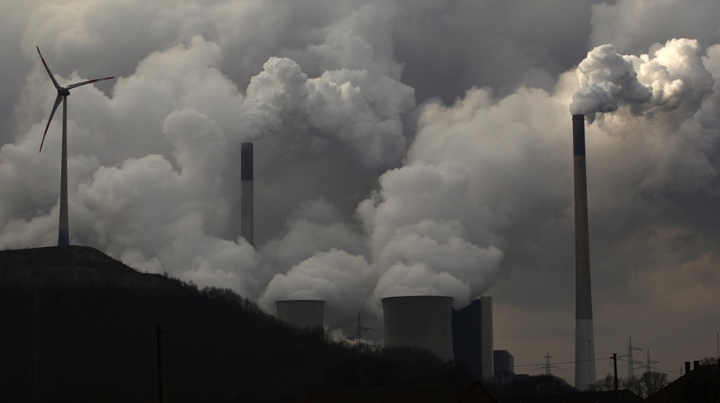
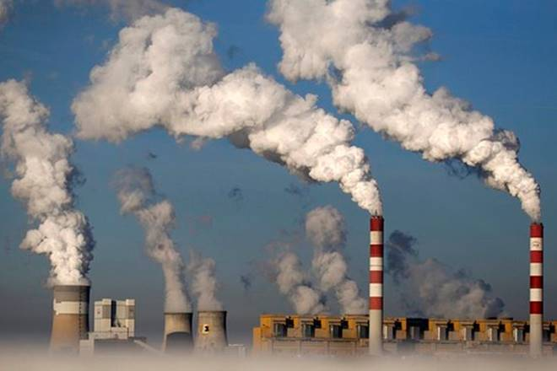
Air Pollution.

Slide 7
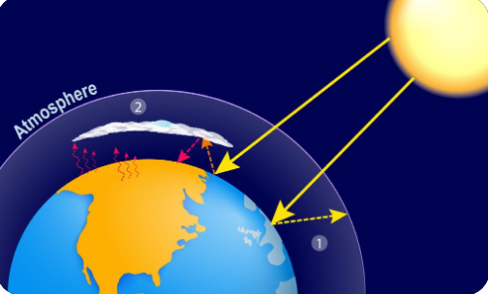
Causes of air pollution.
Major cause of air pollution.
Pollution enters the Earth’s atmosphere in many different ways.
Most air pollution is created by people, taking form of emissions from factories, car, planes, or aerosol cans.
Second-hand cigarette smoke is also considered air pollution.

Slide 8
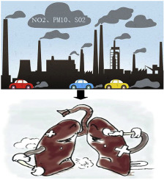
Effect’s Of Air Pollution In Pakistan.
Health Effect’s : Air pollution may cause of short-term or long-term health effects on human beings. Respiratory and inflammatory disorders of air pollution. It also affects eyes; nose and throat, even increasing chance of heart attack.
Environmental Effect’s : Air pollution adversely affect’s plants and animals and it is responsible for environmental changes in the atmosphere. Global temperature has risen for so many years due to air pollution. It is also responsible for causing the effect of ozone depletion, global climate change are also the environmenral effects of air pollution.

Slide 9
Water Pollution.
Water pollution is the contamination of water sources by substances which make the water unusable for drinking, cooking, cleaning, swimming, and other activities.

Slide 10
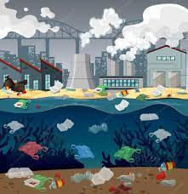
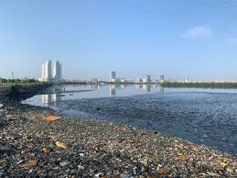

CAUSES IN PAKISTAN
Industrial Waste. ...
Marine Dumping. ...
Sewage and Wastewater. ...
Oil Leaks and Spills. ...
Agriculture. ...
Global Warming. ...

Slide 11
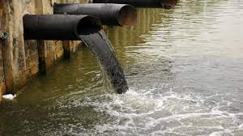
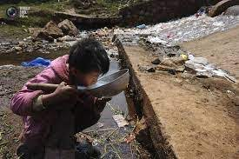
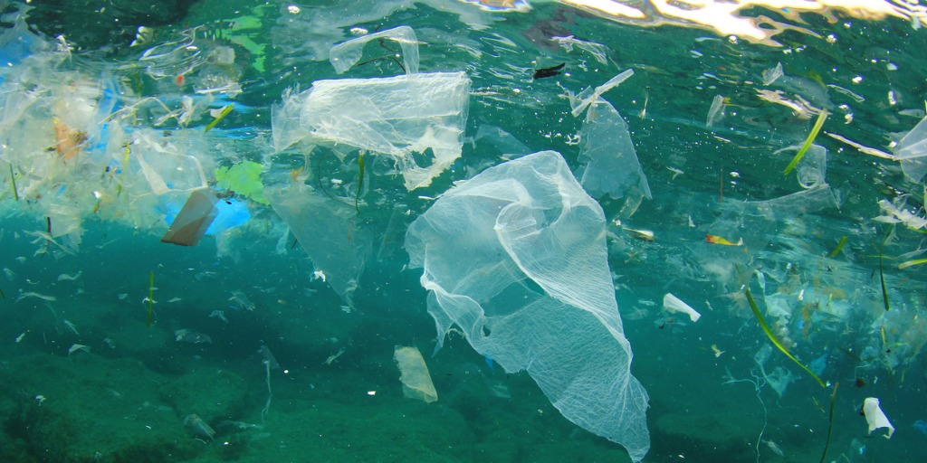
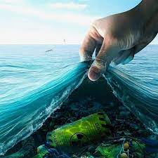
Water pollution

Slide 12
NOISE POLLUTION
Noise pollution can be defined as any disturbing or unwanted noise that interferes or harms humans or wildlife

Slide 13
CAUSES IN PAKISTAN
Traffic noise.
Air traffic noise.
Construction sites.
Catering and night life.
Animals

Slide 14
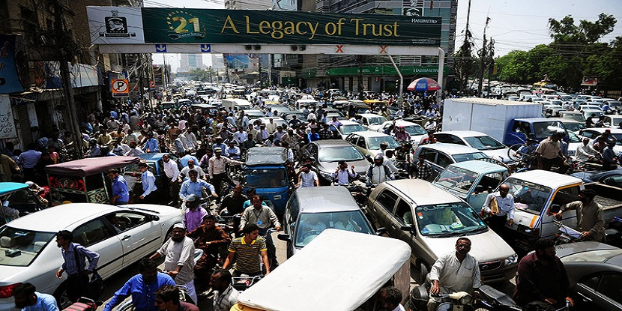
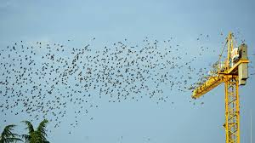
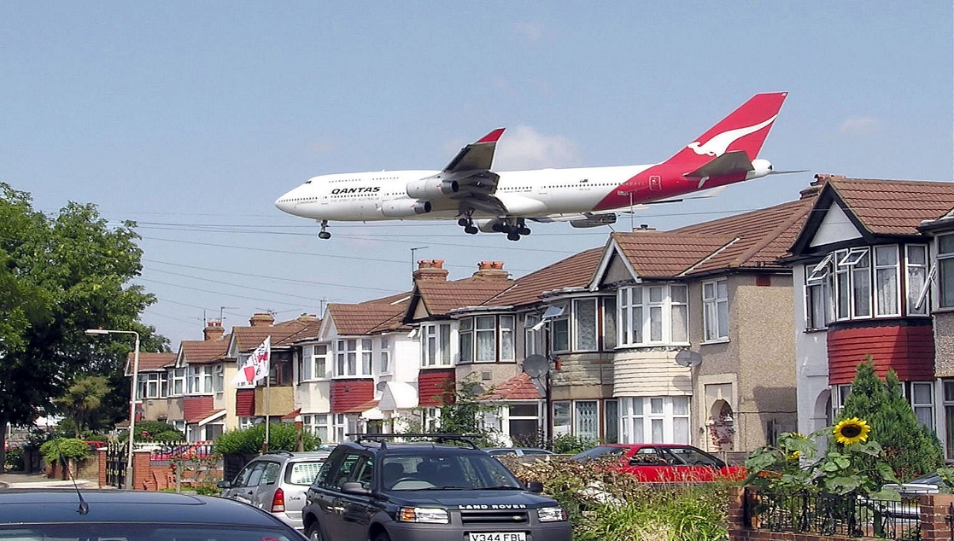
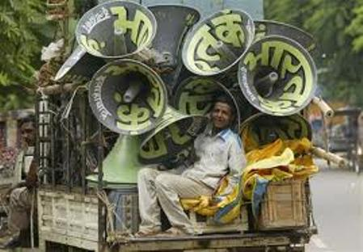
NOISE POLLUTION

Slide 15
What Government do??
Government do nothing in this dangerous situation
More than thousands people were died day by day due to diseases increasing in our country.
Officers are corrupted and sleeping in their comfortable zone.

Slide 16
How Can we control on Pollution??
Reduce the number of trips you take in your car.
Reduce or eliminate fireplace and wood stove use.
Avoid burning leaves, trash, and other materials.
Avoid using gas-powered lawn and garden equipment.

Slide 17


